Slide 1
Focal 2018 Performance reviews job aid

Slide 2
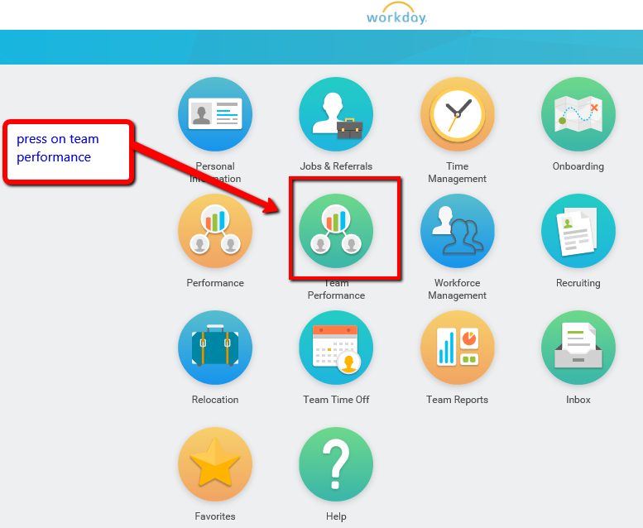
Enter Workday homepage, click on “Team Performance”

Slide 3
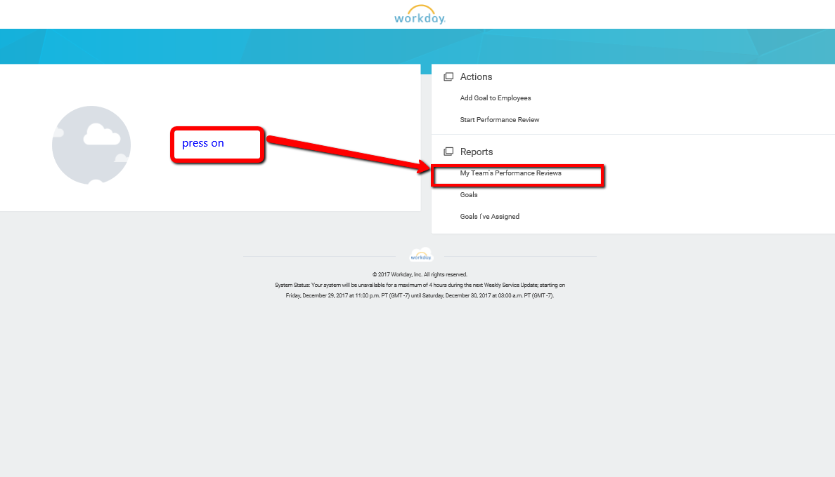
Click on “My Team’s Performance Reviews”

Slide 4
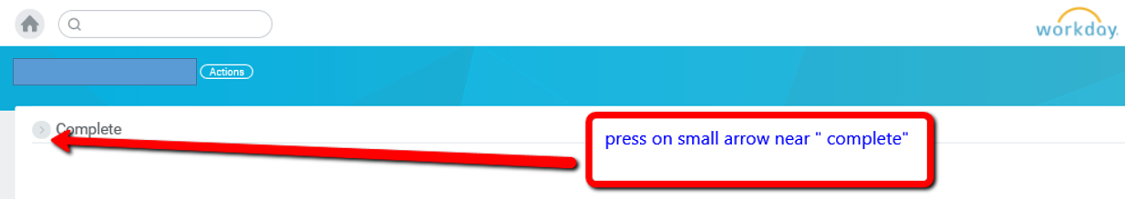
Click on the small arrow marked below

Slide 5
After data is loaded, click on the excel icon to export data

